Slide 1

WIPRO NGA Program – 25SUB4530_CP_JAVA
Capstone Project Presentation – 9th Feb & 10th Feb 2026
E-commerce Order Management System
Batch - 11
Presented by -
58674 - Abhinay Matam
58664- Nandyala Siva Sai Danush
www.rpsconsulting.in

Slide 2

Introduction:
This E-Commerce Order Management System streamlines online shopping by efficiently handling products, orders, and delivery statuses.
The application features a responsive Angular frontend, offering distinct dashboards for admins and customers to manage their activities.
Built on a robust Spring Boot backend with Spring Data JPA, it ensures secure, reliable, and high-performance data processing.
To ensure scalability and high availability, the system is containerized with Docker and deployed on the Azure cloud platform.
Key capabilities include real-time product inventory management and comprehensive order lifecycle tracking from placement to delivery.
This full-stack solution demonstrates modern DevOps practices, combining powerful frameworks to solve real-world retail challenges.
2024 - RPS Consulting all rights reserved

Slide 3
Technologies Used:
Frontend
  Angular
  TypeScript
  HTML & CSS
Backend
  Java
  Spring Boot
  Spring Data JPA
  Hibernate
  MySQL
DevOps & Deployment
  Docker
  Azure App Service
  GitHub
2024 - RPS Consulting all rights reserved

Slide 4
Implementation:
Project Setup: Initialized the Angular frontend and Spring Boot backend to establish the full-stack architecture.
Database Configuration: Configured MySQL and defined JPA entities to model Products, Users, and Order data.
Backend Development: Implemented secure REST APIs for authentication, product management, and order processing logic.
Frontend Design: Built responsive Angular components for Login, Admin Dashboard, and User Shopping interfaces.
Integration: Connected the frontend to backend services using HttpClient to enable real-time data flow.
Deployment: Containerized the application with Docker and deployed it to Azure for public accessibility.
2024 - RPS Consulting all rights reserved

Slide 5
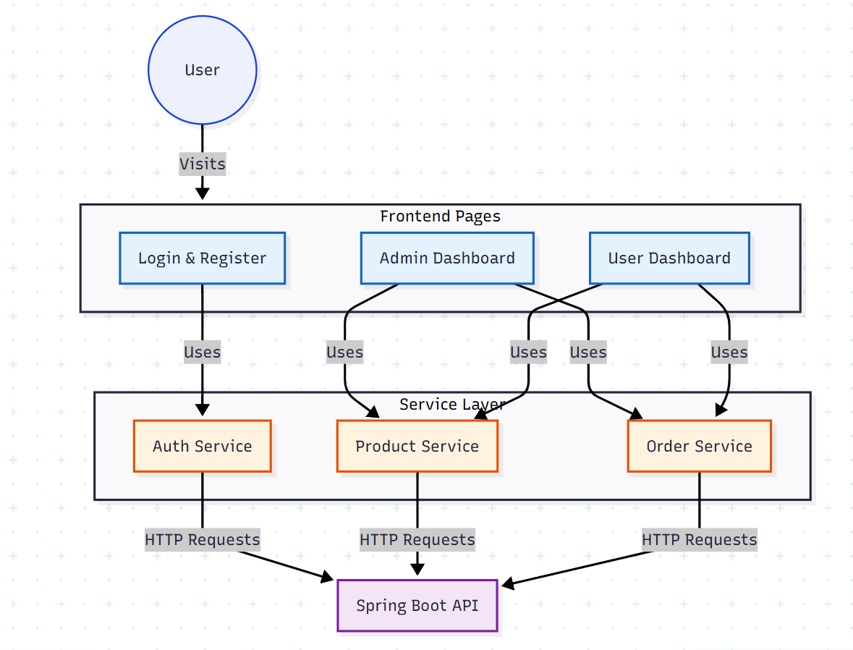
Frontend Architecture:
2024 - RPS Consulting all rights reserved

Slide 6
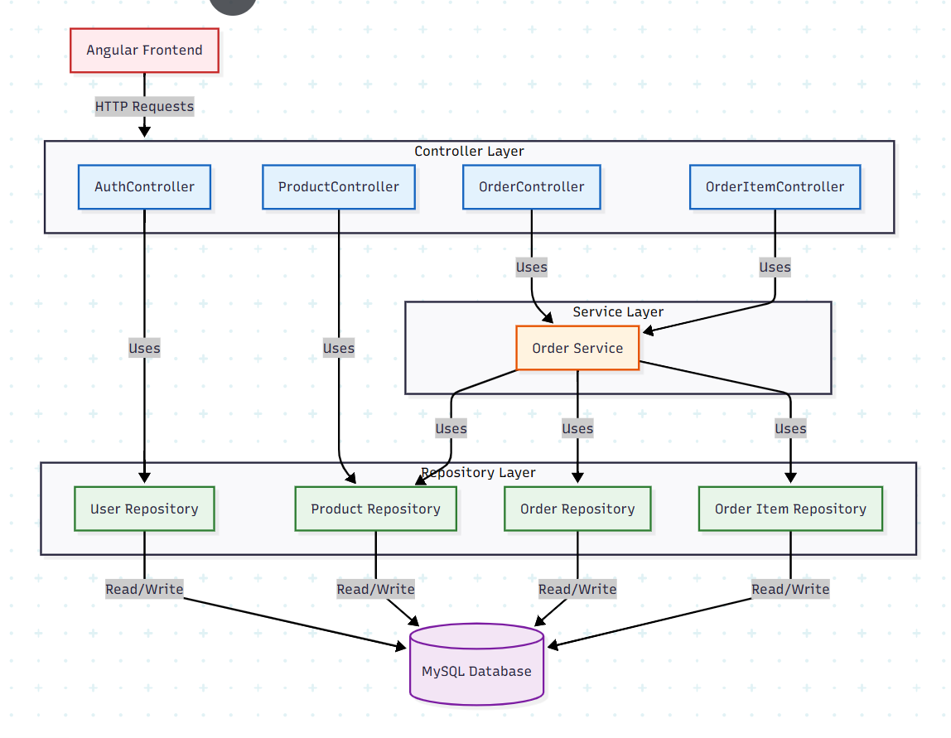
Backend Architecture:
2024 - RPS Consulting all rights reserved

Slide 7
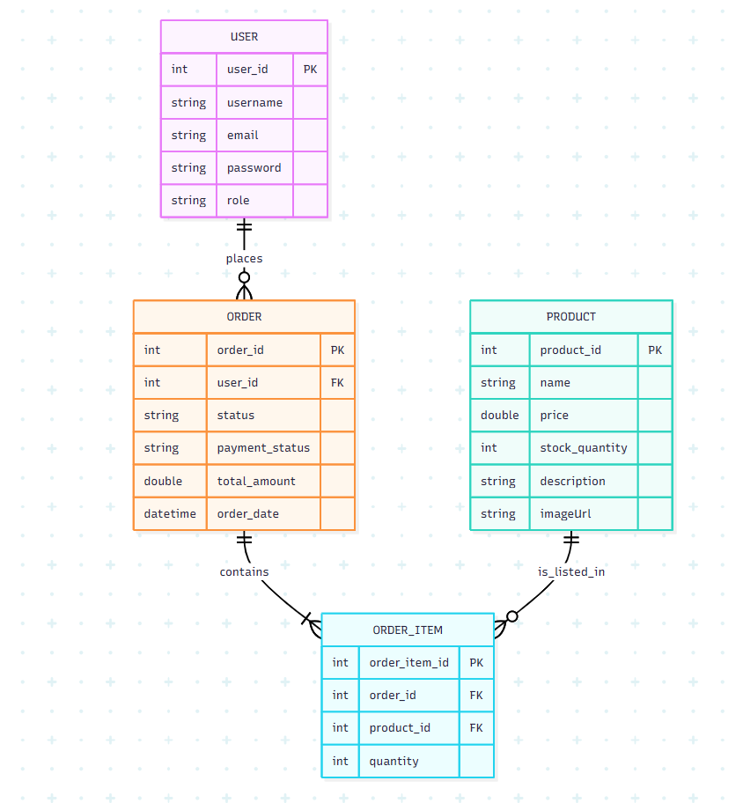
Database Implementation:
2024 - RPS Consulting all rights reserved

Slide 8
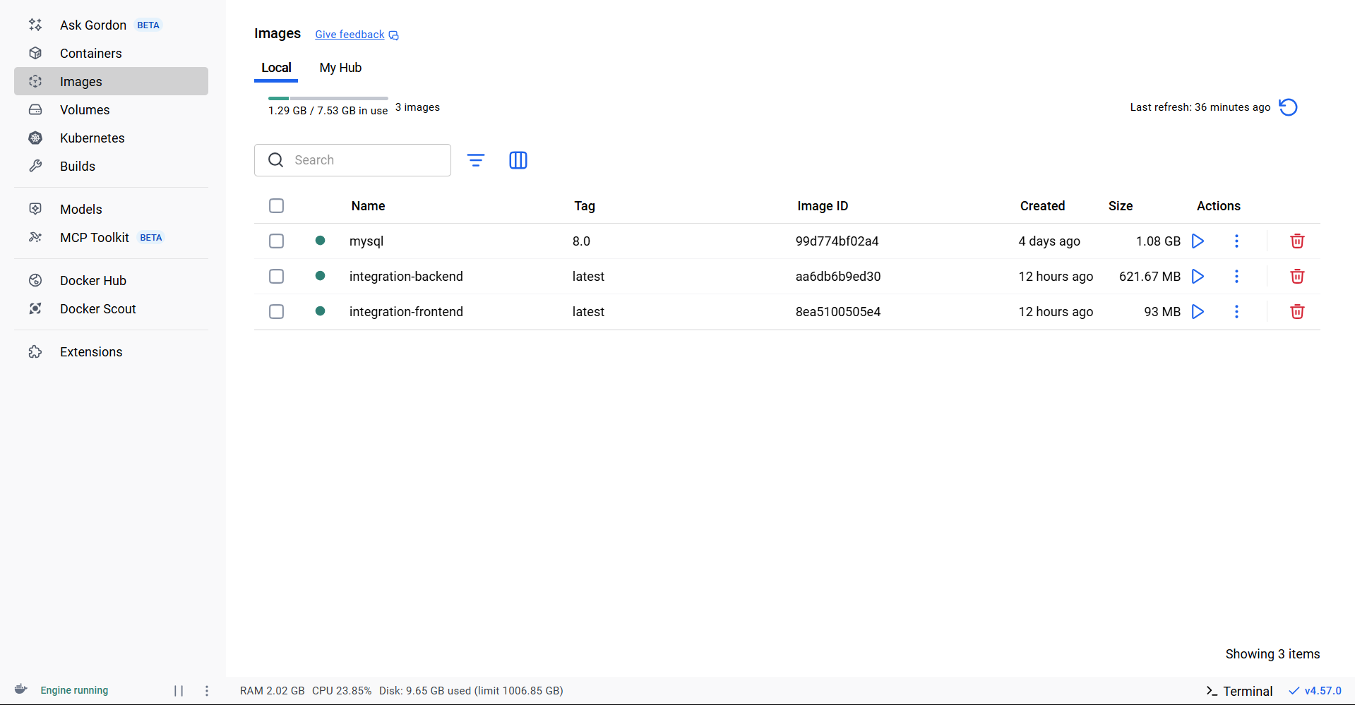
Docker Implementation:
2024 - RPS Consulting all rights reserved

Slide 9
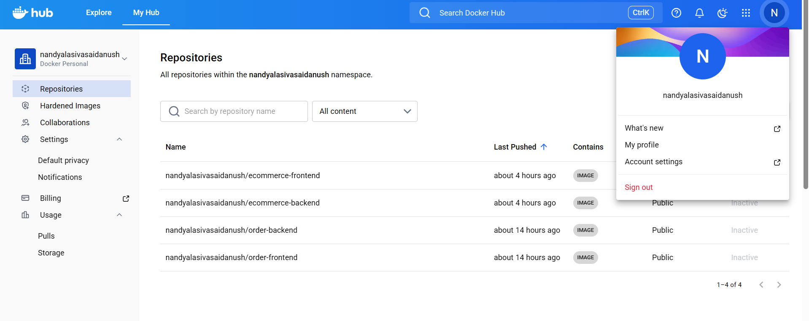
Docker Implementation:
2024 - RPS Consulting all rights reserved

Slide 10
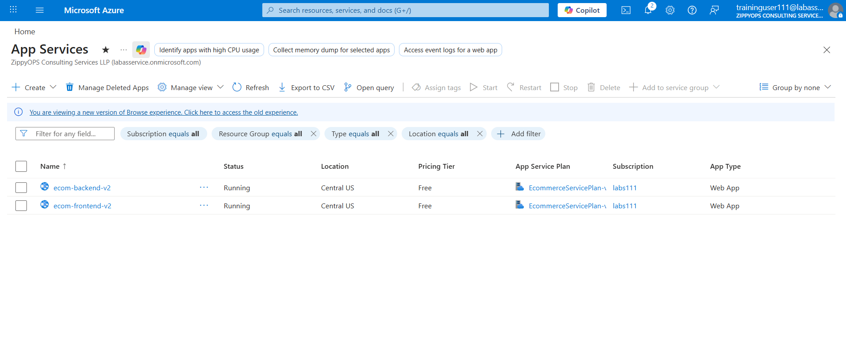
Azure Deployment:
2024 - RPS Consulting all rights reserved

Slide 11
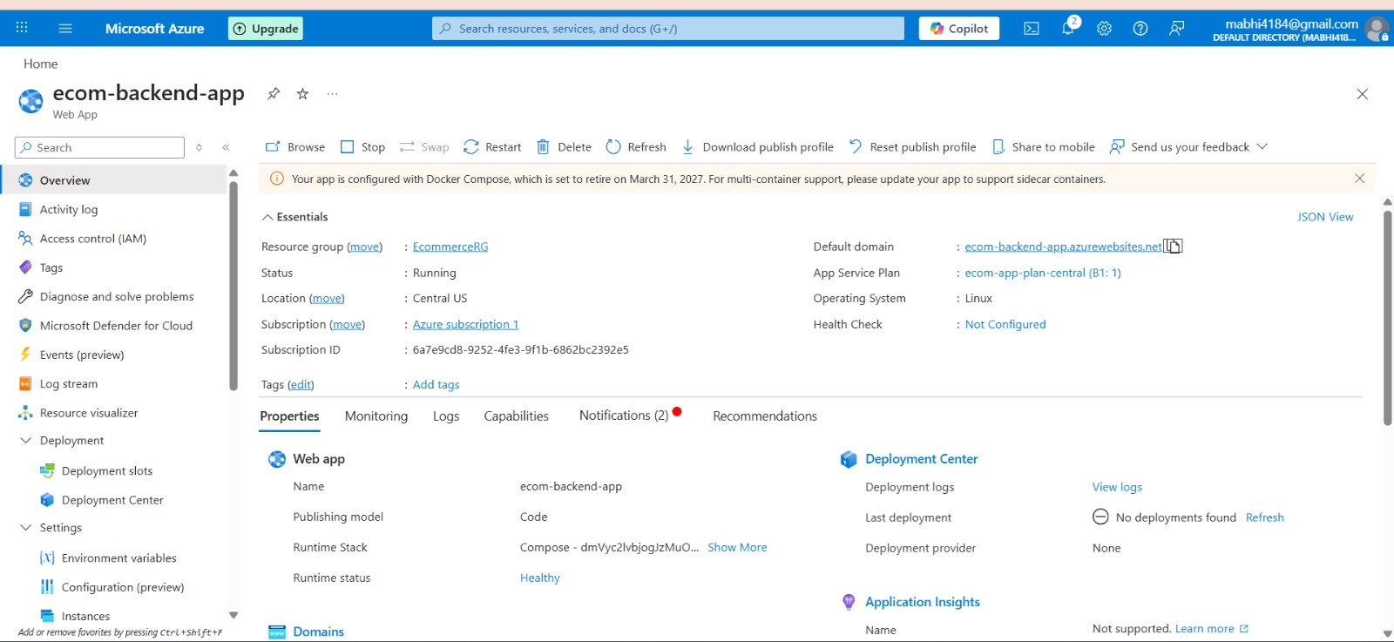
Azure Deployment:
2024 - RPS Consulting all rights reserved

Slide 12
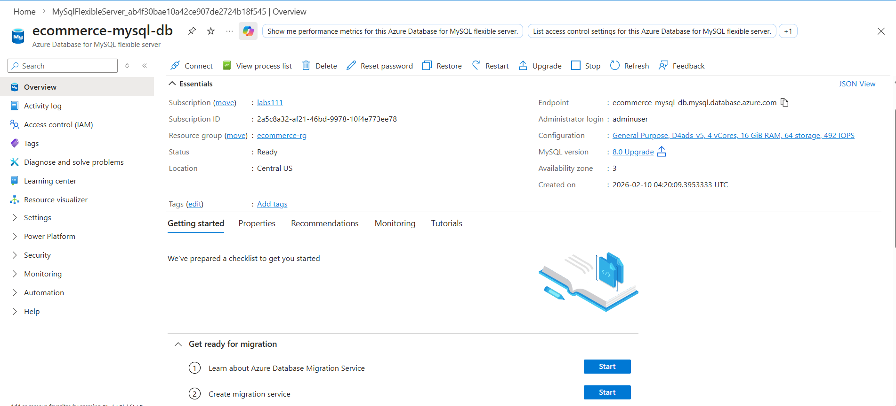
Azure Deployment:
2024 - RPS Consulting all rights reserved

Slide 13
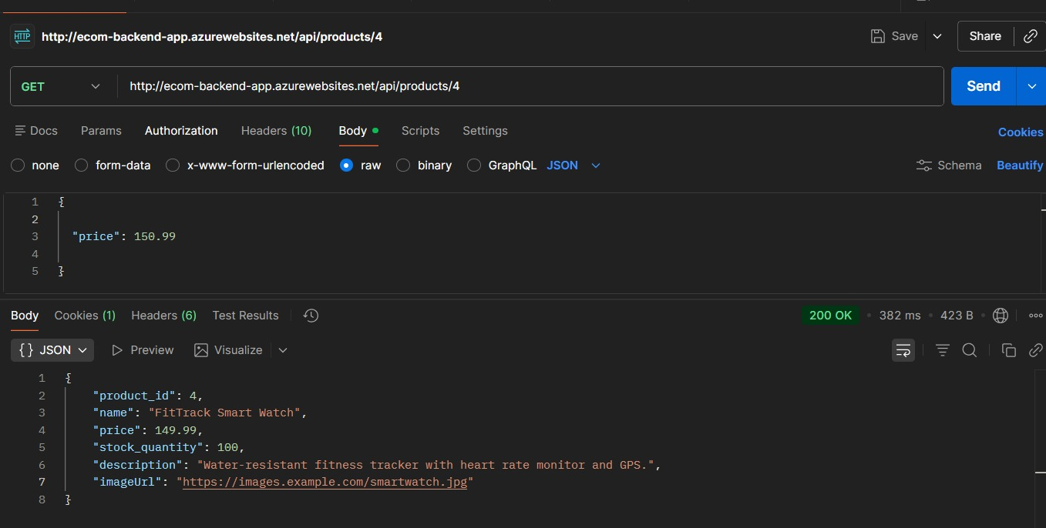
2024 - RPS Consulting all rights reserved

Slide 14
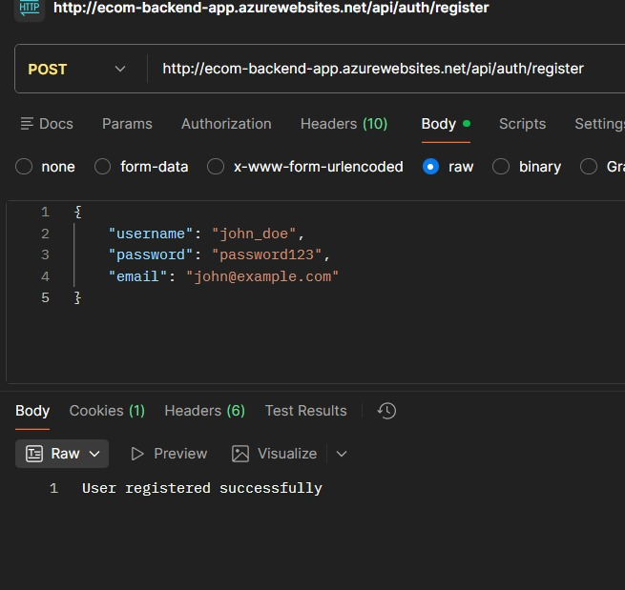
2024 - RPS Consulting all rights reserved

Slide 15
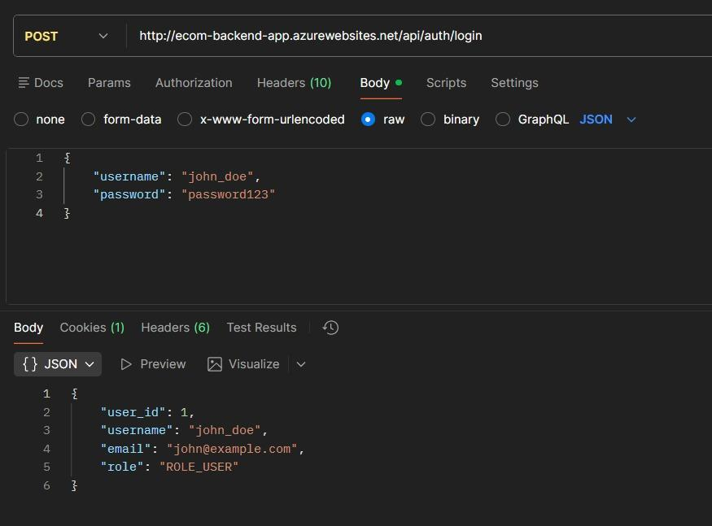
2024 - RPS Consulting all rights reserved

Slide 16
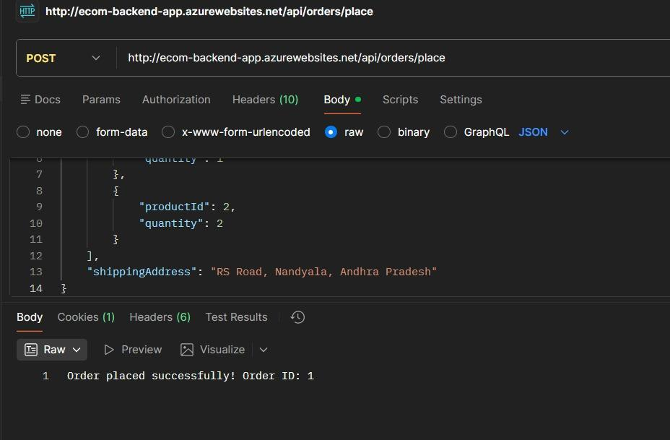
2024 - RPS Consulting all rights reserved

Slide 17
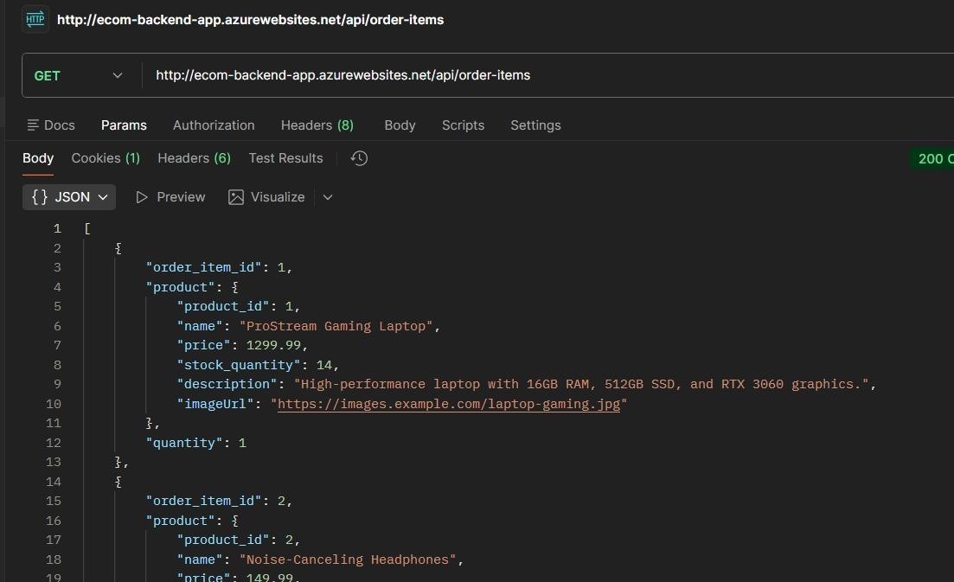
2024 - RPS Consulting all rights reserved

Slide 18
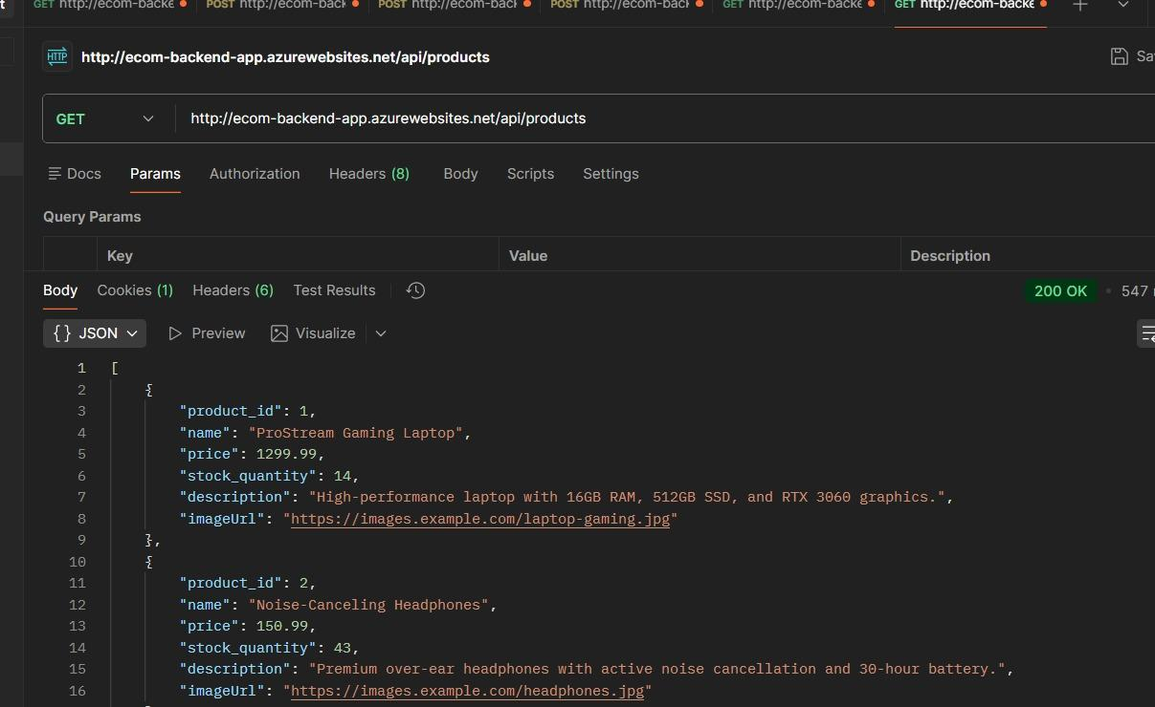
2024 - RPS Consulting all rights reserved

Slide 19
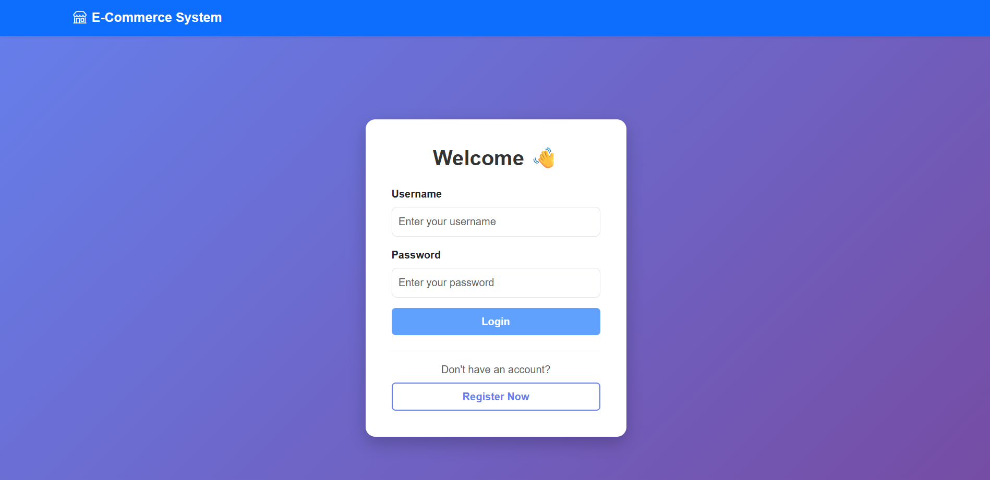
Application Walkthrough:
Login Page:
2024 - RPS Consulting all rights reserved

Slide 20
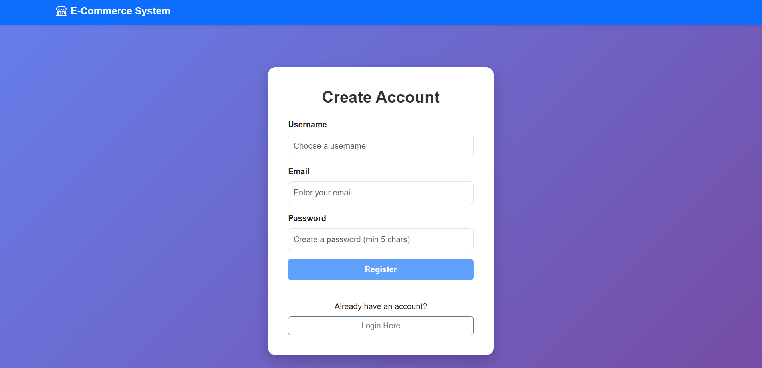
Application Walkthrough:
Registration Page:
2024 - RPS Consulting all rights reserved

Slide 21
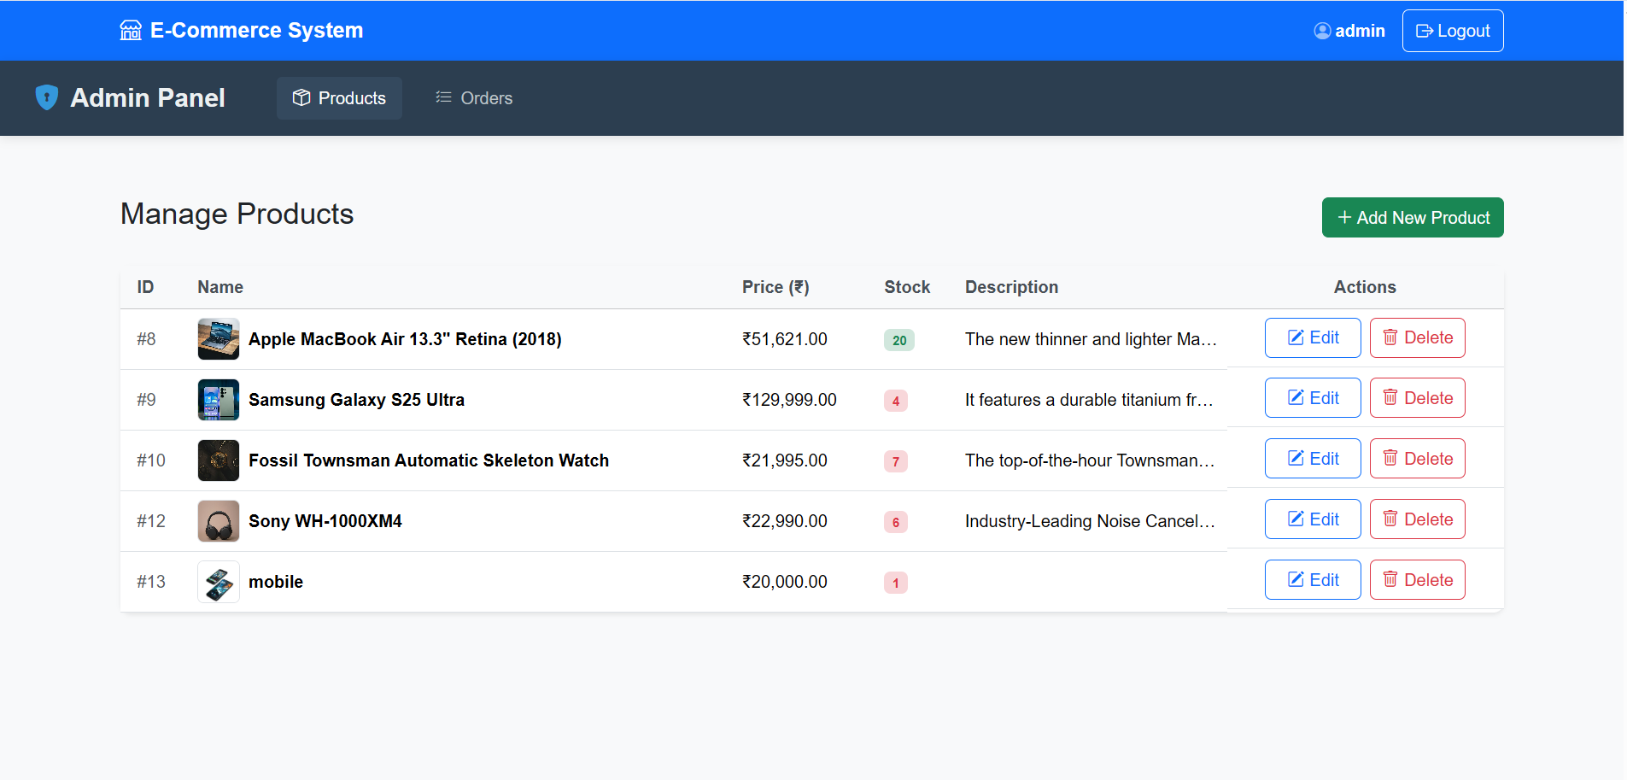
Admin Dashboard:
2024 - RPS Consulting all rights reserved

Slide 22
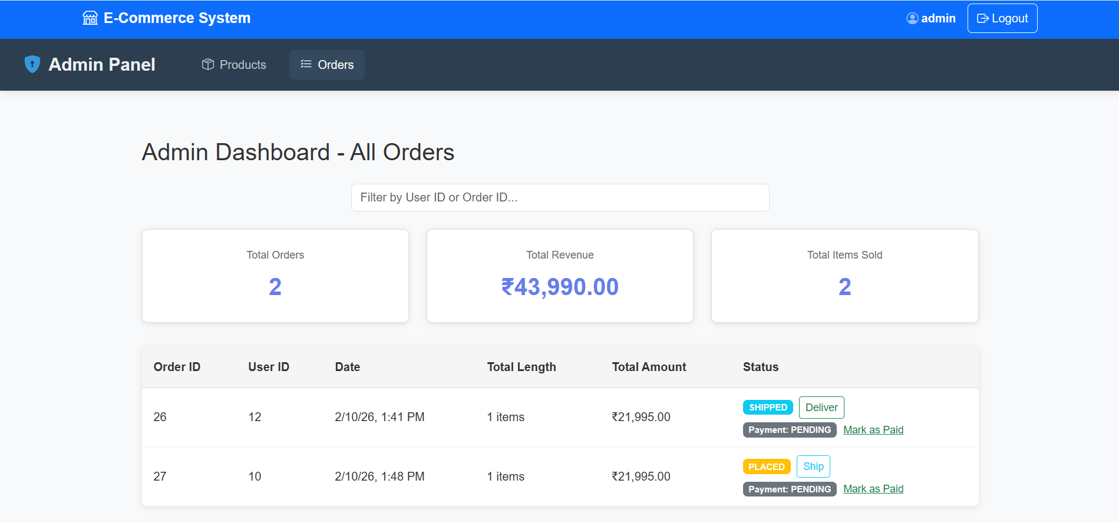
Admin Dashboard:
2024 - RPS Consulting all rights reserved

Slide 23
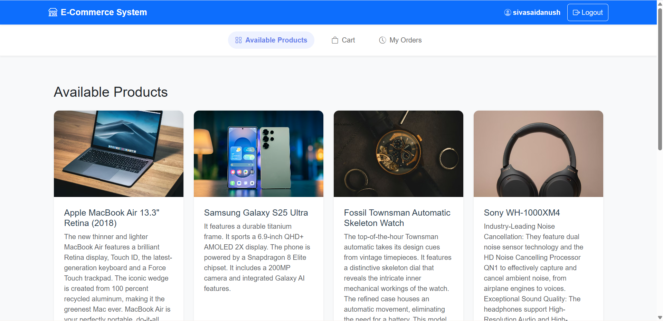
User Dashboard:
2024 - RPS Consulting all rights reserved

Slide 24
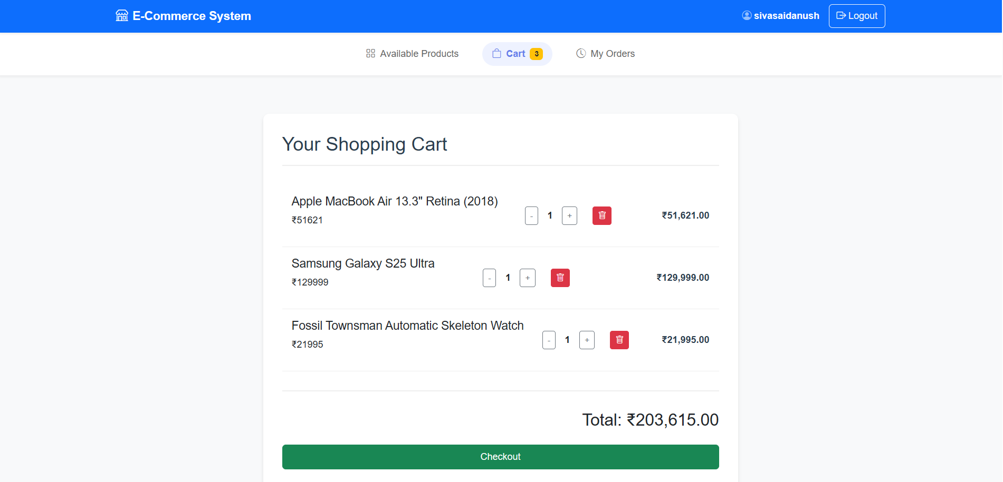
User Dashboard:
2024 - RPS Consulting all rights reserved

Slide 25
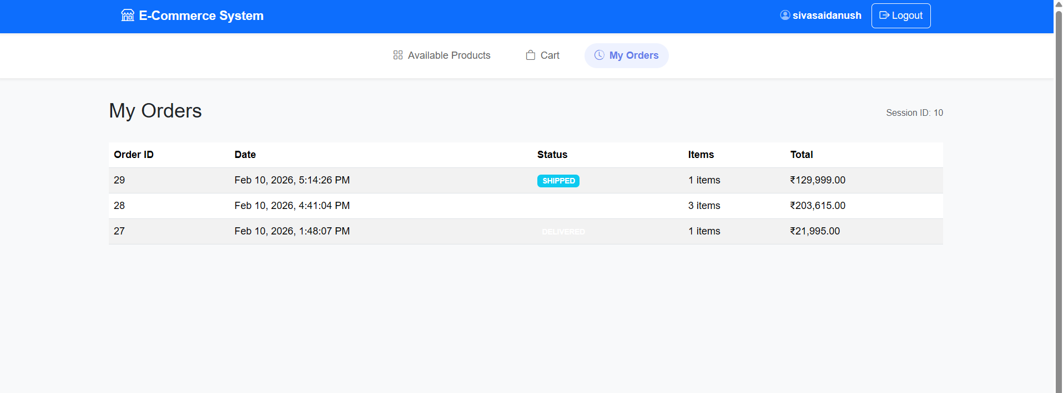
User Dashboard:
2024 - RPS Consulting all rights reserved

Slide 26
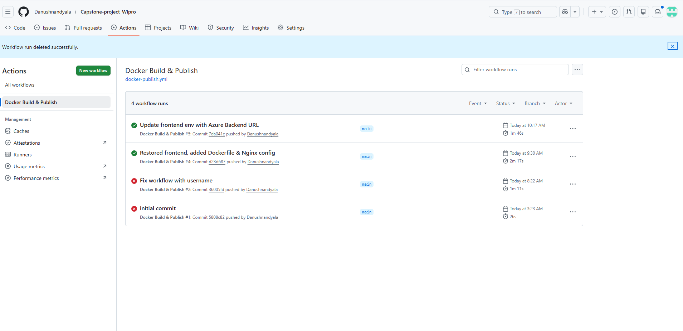
Git Deployment:
2024 - RPS Consulting all rights reserved

Slide 27
Outcome:
Full-Stack Proficiency: Successfully built and integrated a complete web application using Angular (Frontend) and Spring Boot (Backend).
Scalable Deployment: Demonstrated cloud readiness by deploying the system on Azure App Service, ensuring accessibility and high availability.
Secure Architecture: Implemented Role-Based Access Control (RBAC) to secure sensitive administrative data while providing a seamless shopping experience for users.
Real-World Simulation: Delivered a functional E-Commerce platform that handles the complete order lifecycle, solving practical business requirements.
2024 - RPS Consulting all rights reserved

Slide 28
Conclusion:
Mission Accomplished: The project successfully delivers a robust, end-to-end E-Commerce solution, bridging the gap between product management and customer satisfaction.
Modern Architecture: By leveraging Angular, Spring Boot, and Azure, the system is built on industry-standard technologies that ensure performance, security, and scalability.
Future-Ready: The modular design allows for easy integration of advanced features like AI-driven recommendations and multiple payment gateways in future updates.
Closing thought: "This project not only solidified my full-stack development skills but also provided a scalable platform ready for real-world deployment."
2024 - RPS Consulting all rights reserved

